Slide 1

CNN Based iTMO
Presenters: Nishtha Chawla, Qinxin Lin, Zixiao Zhang, Lynx Lu

Slide 2
AGENDA
INTRODUCTION
FRAMEWORK
DATA PROCESSING
MODEL
NETWORK
TRAINING & RESULTS
CHALLENGES

Slide 3
Introduction
Traditional ways
Input SDR images
Use a fixed function or parameterized function
Expand dynamic range of SDR image
Generate HDR image
Notes:
Eg Akyuz

Slide 4
CNN & iTMO
Predict details lost in saturated image areas
Use CNN to predict HDR values
Deep learning techniques show good results in:
1. Artifact reduction
2. Image Translation
Notes:
Why we predict details? To enable HDR reconstruction from single exposure
Compression artifacts reduction by a deep convolutional network,'' in Proc. IEEE Int. Conf. Comput.Vis., Dec. 2015, pp. 576584
Let there be color!: Joint end to-end learning of global and local image priors for automatic image colorization with simultaneous classication,'' ACM Trans. Graph., vol. 35, no. 4, p. 110, 2016.

Slide 5
Related Works
Method 1: Reconstruct saturated areas in input LDR images via a CNN.
Limitation: Applicable only when a CRF used at the time of photographing is given.
Method 2: CNN based method that produce a set of differently exposed images from a single LDR image.
Method 3: Use Neural networks to do luminance learning and color learning separately.
Notes:
Issues method 2: If the given LDR image has wide clipped regions (especially in the case of high-resolution images), the newly synthesized content exhibits tiling artifacts
Issues method 3: Images show difference in bright areas when compared with ground truth images

Slide 6
Framework & Motivation
Inverse tone mapping method using a CNN with SDR based learning
Other methods:
SDR image –> processing –> HDR image
Proposed method:
Learn transformation between Input SDR images & SDR images processed via Reinhard global operator.
Apply inverse transform of Reinhard’s global operator to SDR images produced by CNNs.

Slide 7
Overview - Train
Step 1 - Input SDR image x from HDR image E by using a virtual camera with various CRFs.
Step 2 - Generate target SDR image y from HDR image by using Reinhard’s global operator with parameter a = 0:18
Step 3 - Train a CNN to transform input LDR image x into target LDR image y i.e. input x SDR and output y SDR.
HDR
Image
Reinhard’s global operator
Virtual Camera
E
HDR image – E
SDR image x – via CRF
SDR image y – from Reinhard TMO
CNN- input x SDR and output y SDR
x
x
CNN
y
y
SDR
Image
SDR
Image
Notes:
HDR image – E
SDR image x – via CRF
SDR image y – from reinhard
CNN- input x SDR and output y SDR

Slide 8
Overview - Predict
Step 1: x is SDR image taken with a digital camera..
Step 2: Transform x into Y by using the trained CNN. This transformation aims to estimate an LDR image generated by Reinhard’s global operator
Step 3: Generate an HDR image Y’ from Y by using inverse transform of reinhard using parameter a = 0:18
Camera
SDR
SDR
x
CNN
Y
Y
x = SDR image from digital camera
Y= SDR image given by CNN
Y’= HDR image by applying inverse Reinhard on SDR given by CNN
Y’
Inverse tone-map Y
Predicted HDR
Notes:
x = SDR image from digital camera
Y= SDR image given by CNN
Y’= HDR image by applying inverse reinhard on SDR given by CNN

Slide 9
Data Processing
Original HDR Data
Image Cropping
Training Set: 512*512 pixels
Test set: 512*512 pixels
Number | Size | Format | Source | Use
779 | 1920*1080 | OpenEXR | UBC | Training set
50 | 2141*1421 | Radiance HDR | SFU | Test set

Slide 10
Data Processing
Image Cropping
Training Set
Crop original HDR image with 1920*1080 pixels to an image with 512*512 pixels
For one image, crop four image patches
Select 2400 images from 3116 images as a training dataset for CNN
Patches | Positon of Patch
Patch 1 | (200, 300)
Patch 2 | (1000, 100)
Patch 3 | (512, 512)
Patch 4 | (704, 284)
Total number of training set images | 4*779 = 3116

Slide 11
Data Processing
Image Cropping
Test Set
Crop original HDR image with 2141*1421 pixels to an image with 512*512 pixels
Test set: for one image, crop center area as one image patch
50 images as a test dataset for CNN
Patches | Position of Patch
Patch 1 | (814, 454)
Total number of test set images | 50

Slide 12
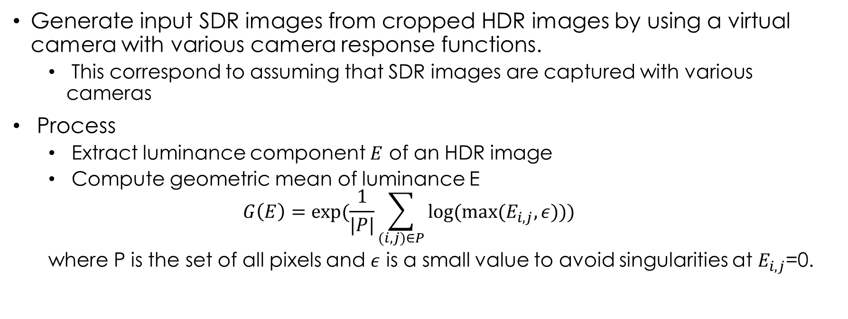
SDR Images by Virtual Camera
Generate input SDR images from cropped HDR images by using a virtual camera with various camera response functions.
This correspond to assuming that SDR images are captured with various cameras
Process
Extract luminance component $E$ of an HDR image
Compute geometric mean of luminance E
$$G\left(E\right)=exp⁡(\frac{1}{|P|}\sum_{(i,j)∈P}{log⁡(max⁡(E_{i,j},ε))})$$
where P is the set of all pixels and $ε$ is a small value to avoid singularities at $E_{i,j}$=0.

Slide 13
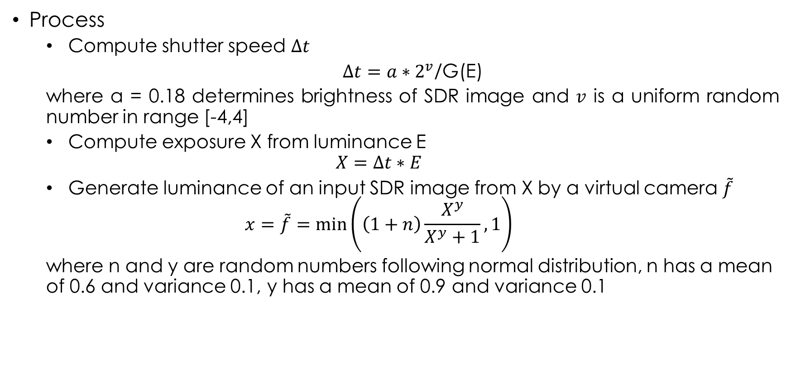
SDR Images by Virtual Camera
Process
Compute shutter speed $∆t$
$∆t=a∗2^{v}$/G(E)
where a = 0.18 determines brightness of SDR image and $v$ is a uniform random number in range [-4,4]
Compute exposure X from luminance E
$$X=∆t∗E$$
Generate luminance of an input SDR image from X by a virtual camera $\tilde{f}$
$$x=\tilde{f}=\min\left(\left(1+n\right)\frac{X^{y}}{X^{y}+1},1\right)$$
where n and y are random numbers following normal distribution, n has a mean of 0.6 and variance 0.1, y has a mean of 0.9 and variance 0.1

Slide 14
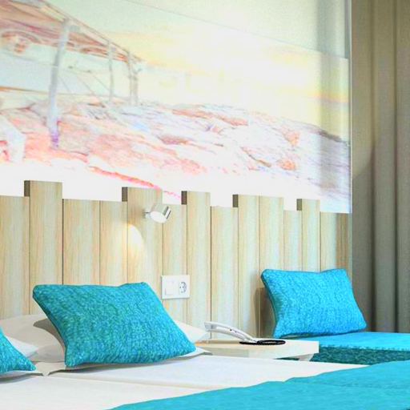
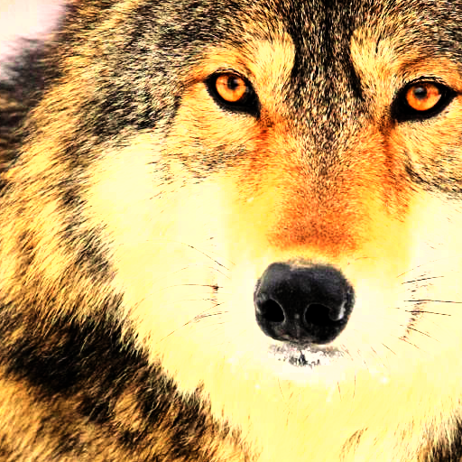

SDR Images by Virtual Camera
Process
Generate SDR image by multiplying the luminance ratio of the SDR and HDR images by the RGB color channel of the HDR image.
SDR images generated by virtual camera

Slide 15
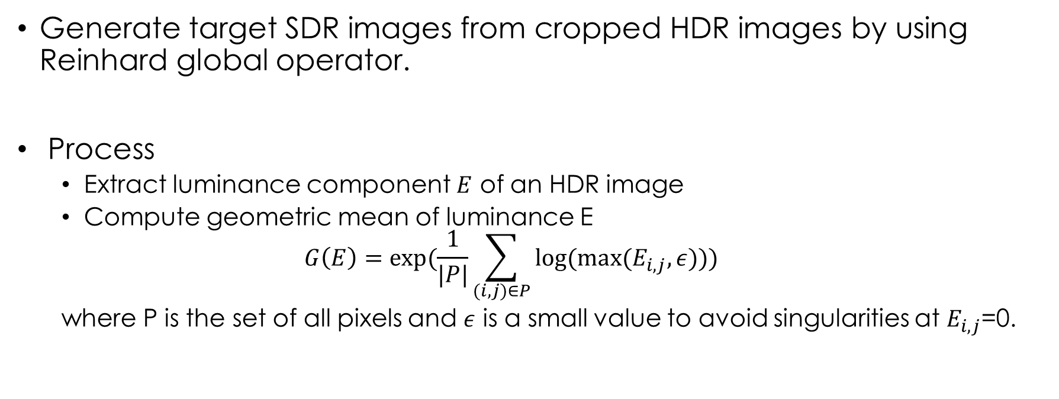
SDR Images by Reinhard Global Operator
Generate target SDR images from cropped HDR images by using Reinhard global operator.
Process
Extract luminance component $E$ of an HDR image
Compute geometric mean of luminance E
$$G\left(E\right)=exp⁡(\frac{1}{|P|}\sum_{(i,j)∈P}{log⁡(max⁡(E_{i,j},ε))})$$
where P is the set of all pixels and $ε$ is a small value to avoid singularities at $E_{i,j}$=0.

Slide 16
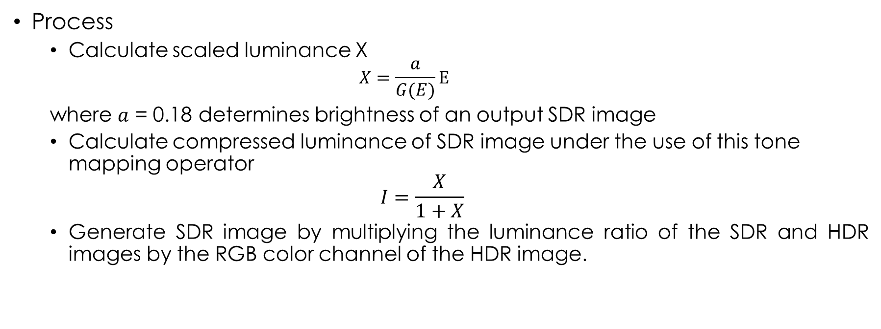
SDR Images by Reinhard Global Operator
Process
Calculate scaled luminance X
$$X=\frac{a}{G(E)}E$$
where $a$ = 0.18 determines brightness of an output SDR image
Calculate compressed luminance of SDR image under the use of this tone mapping operator
$$I=\frac{X}{1+X}$$
Generate SDR image by multiplying the luminance ratio of the SDR and HDR images by the RGB color channel of the HDR image.

Slide 17
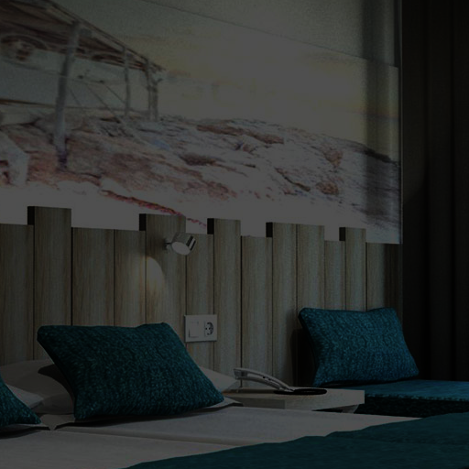
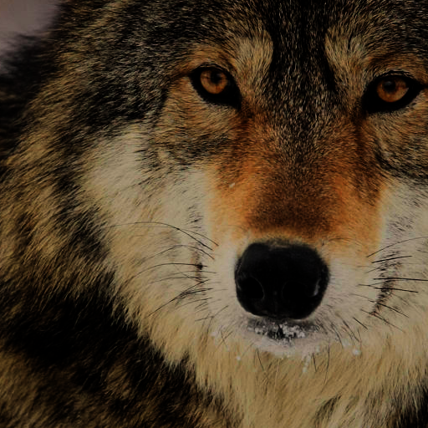

SDR Images by Reinhard Global Operator
SDR images generated by Reinhard global operator

Slide 18
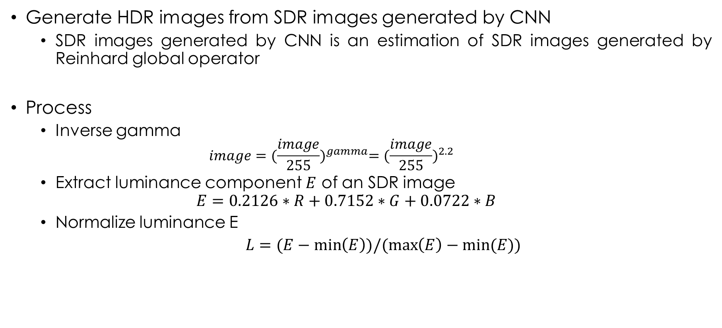
Inverse Transform of Reinhard Operator
Generate HDR images from SDR images generated by CNN
SDR images generated by CNN is an estimation of SDR images generated by Reinhard global operator
Process
Inverse gamma
$$image={(\frac{image}{255})}^{gamma}={(\frac{image}{255})}^{2.2}$$
Extract luminance component $E$ of an SDR image
$$E=0.2126∗R+0.7152∗G+0.0722∗B$$
Normalize luminance E
$L=(E−\min\left(E\right))/(\max\left(E\right)−min⁡(E))$

Slide 19
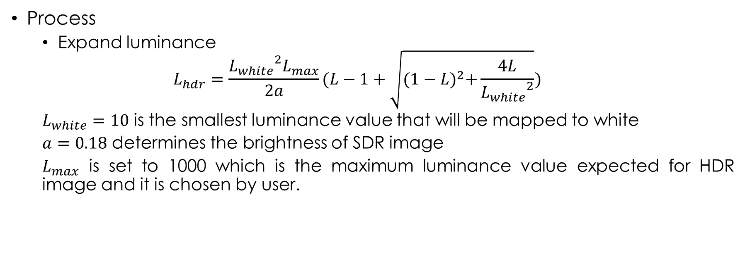
Inverse Transform of Reinhard Operator
Process
Expand luminance
$$L_{hdr}=\frac{{L_{white}}^{2}L_{max}}{2a}(L−1+\sqrt{{(1−L)}^{2}+\frac{4L}{{L_{white}}^{2}}})$$
$L_{white}=10$ is the smallest luminance value that will be mapped to white
$a=0.18$ determines the brightness of SDR image
$L_{max}$ is set to 1000 which is the maximum luminance value expected for HDR image and it is chosen by user.

Slide 20
Inverse Transform of Reinhard Operator
Process
1) Generate HDR image by multiplying the luminance ratio of the HDR and SDR images by the RGB color channel of the SDR image
2) Convert Gamut from BT.709 to BT.2020
3) Apply PQ SMPTE ST 2084
4) Save HDR image with OpenEXR format

Slide 21
CNN Structure
Input Image Size: 512*512*3.
19 convolutional layers, 4 max pooling layers (max pooling).
Reference Network: U-net.
Components: Encoder, Decoder & Skip connections.
Activation Function: ReLU (except that we use sigmoid for output).

Slide 22
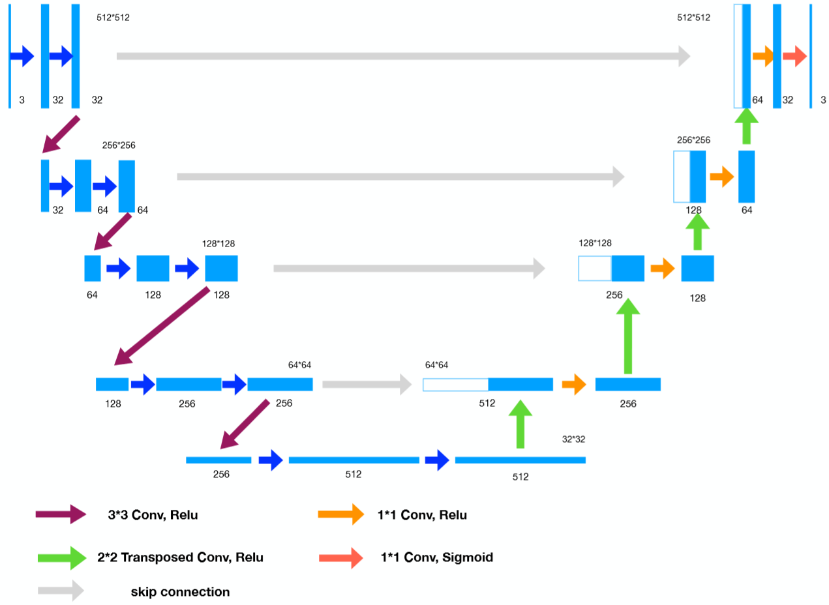
Network

Slide 23

Network Details – Basic Layout
Number of the filter: 32, 64, 128, 256, 512.
Filter Size (Encoder): 3*3.
Filter Size (Decoder & Output): 2*2.
Max pooling layer: kernel size (2*2), stride (2).

Slide 24

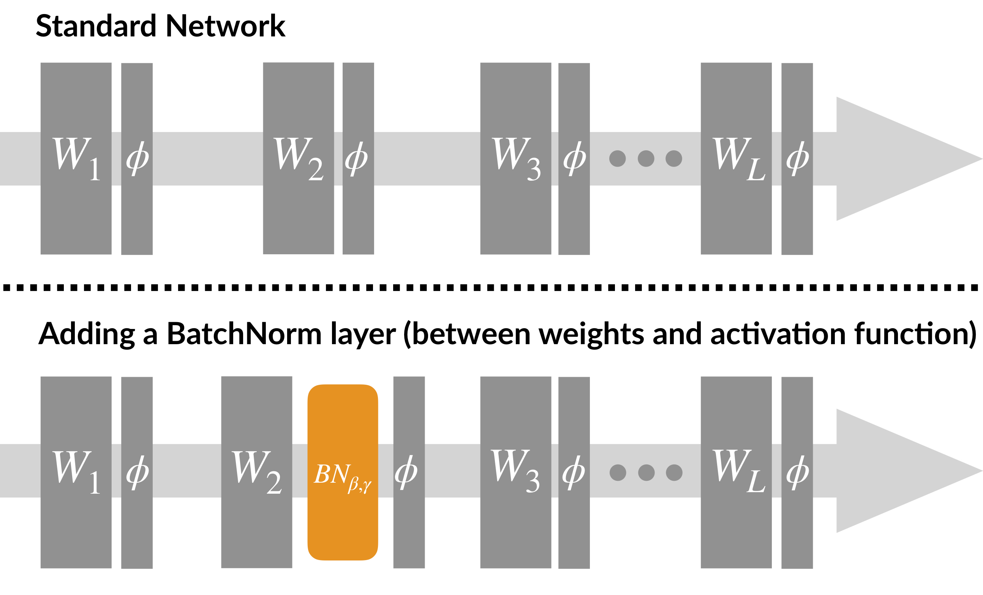
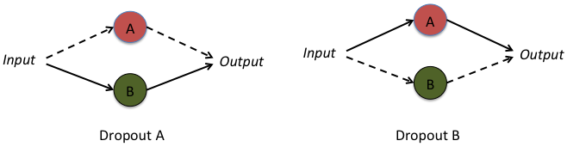
Network Details – Additional Features
Dropout is implemented to deal with overfitting in 4th and 5th convolutional block.
We apply Batch Normalization to outputs of ReLU functions after convolutional layers to solve covariance shift.

Slide 25

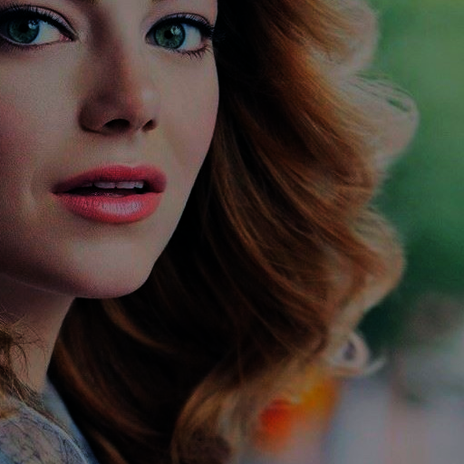
Training Methodology - Input
Input – 2400 Total Images (2000 Training images and 400 used for validation)
Output – Corresponding 2400 Images with Reinhardt Applied as Ground Truth
Scaling: 0 – 255 (uint8) to 0 – 1 (float)
Loss: MSE across all 3 channels
Output rescaled: 0 – 255 (uint8)
Data Dimension (512 x 512 x 3 x batch size)
SDR – Virtual Camera (In)
SDR – Reinhardt (Out)
Broken down into 3D Matrices of RGB

Slide 26
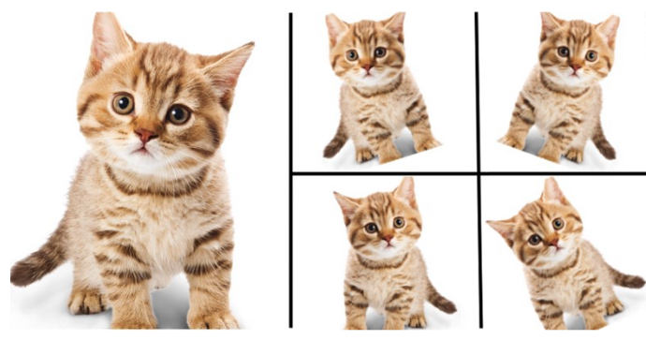
Optimizing Training Performance
Image augmentation: Done every epoch. This allows for a best result for a smaller amount of dataset.
Image Flips – Both Vertical and Horizontal
Image Shuffling – Beginning of Each Epoch
Image Rotations – Rotation Range of 90 degrees
Zoom range – 0.2
Small Batch Size – Only 2 per batch to lessen the effects of overfitting. 1000 batches per epoch. This allows for more frequent weight updates in the CNN.

Slide 27
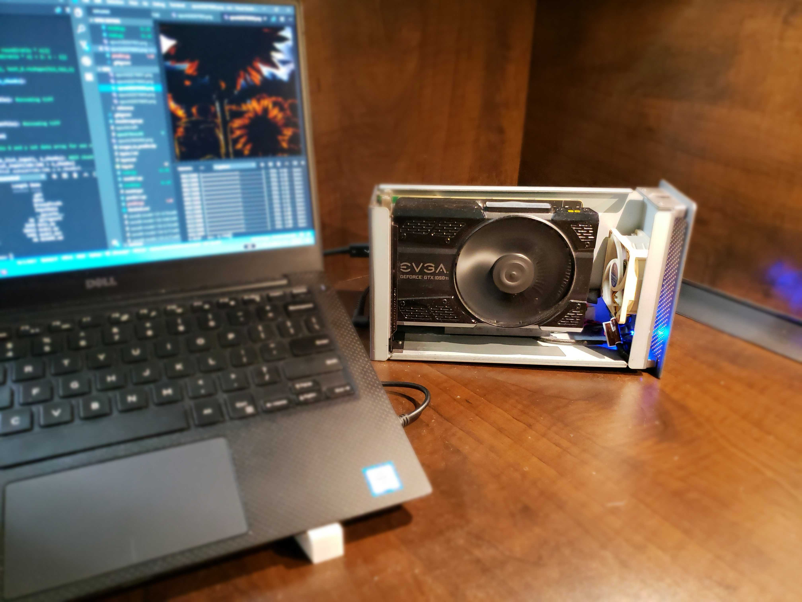
Training Results
CNN Model is capable of lowering the validation loss to 0.05 at around 300 epochs.
Model still running at this moment in time. Hence, a lower validation error may be seen by next week.

Slide 28
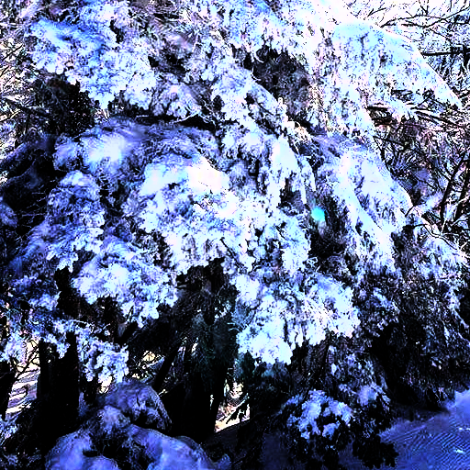
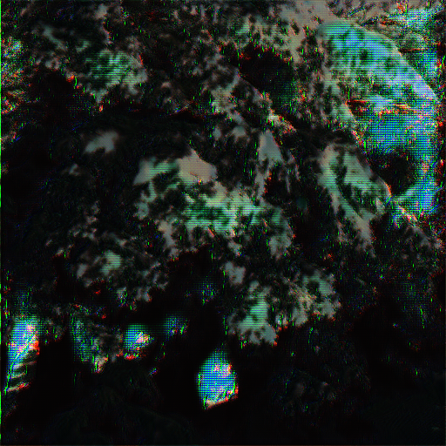
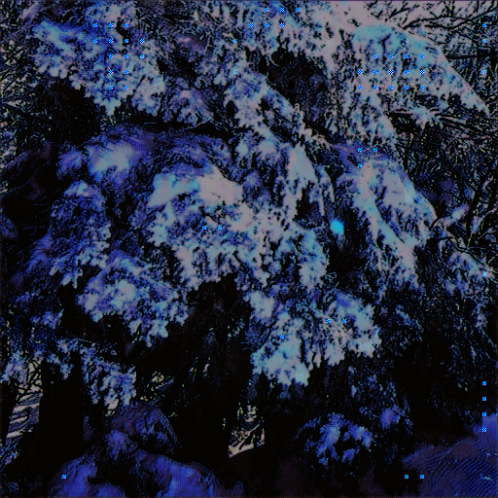
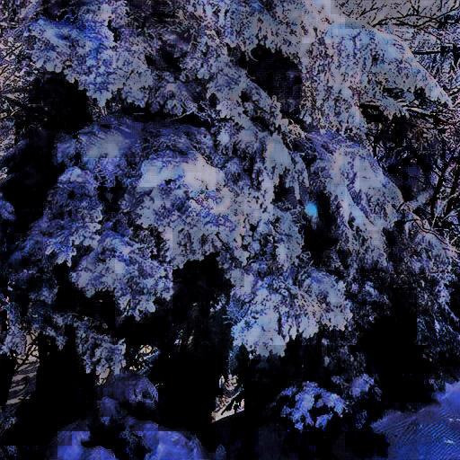
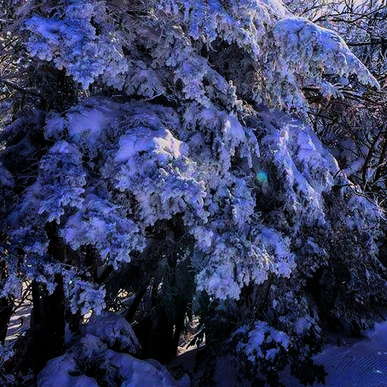
Image Quality Over Time
It can be noted that over increasing number of epochs, the amount of artifacts decrease.
However, there is still discrepancy between prediction and ground truth.
Input
10 Epochs
100 Epochs
300 Epochs
Ground Truth

Slide 29
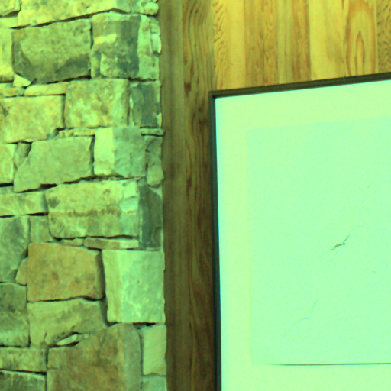
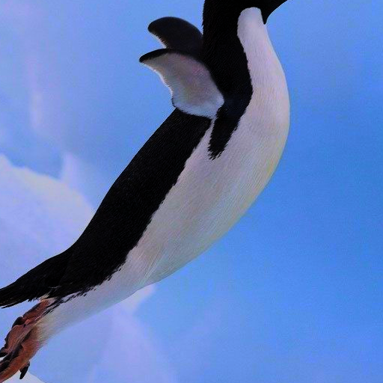

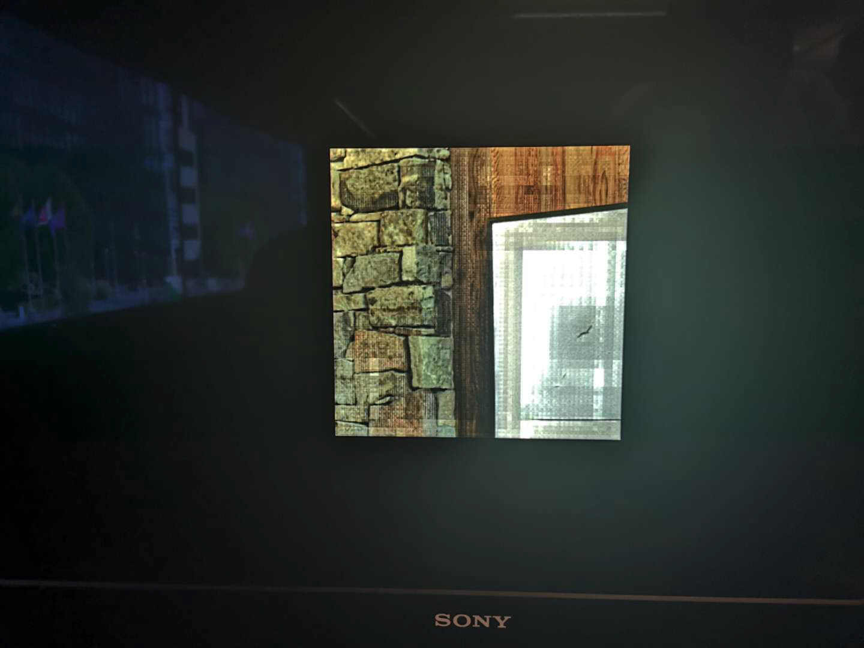
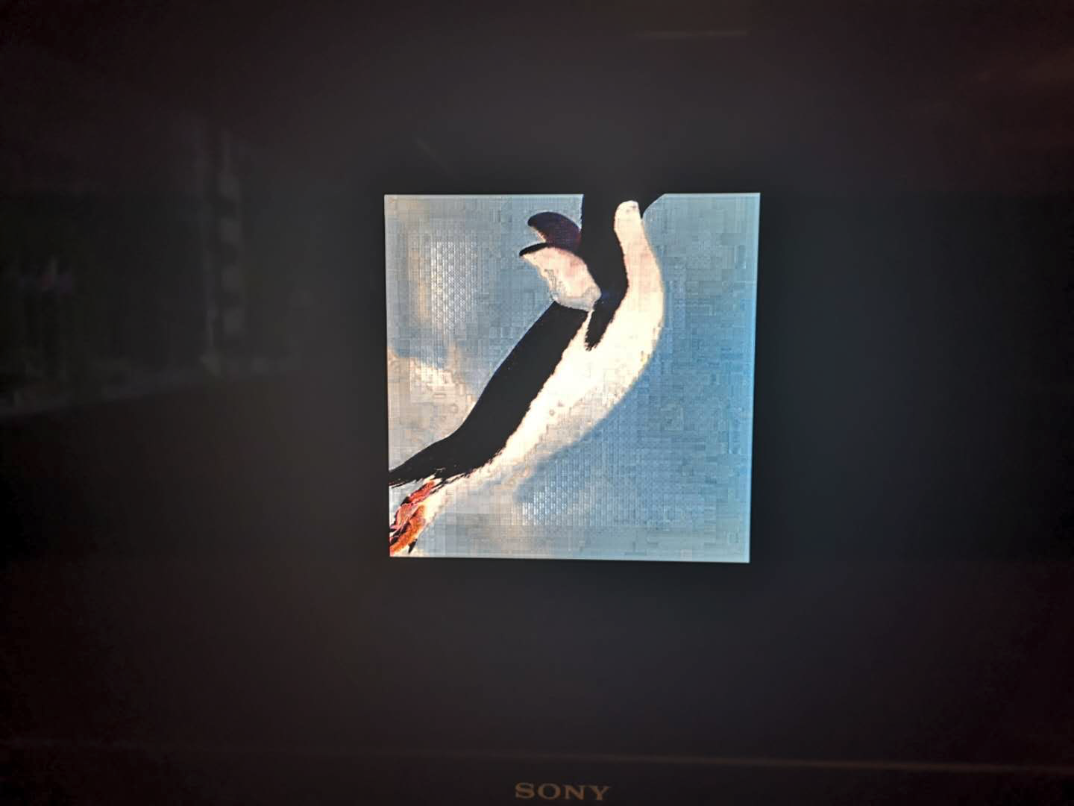
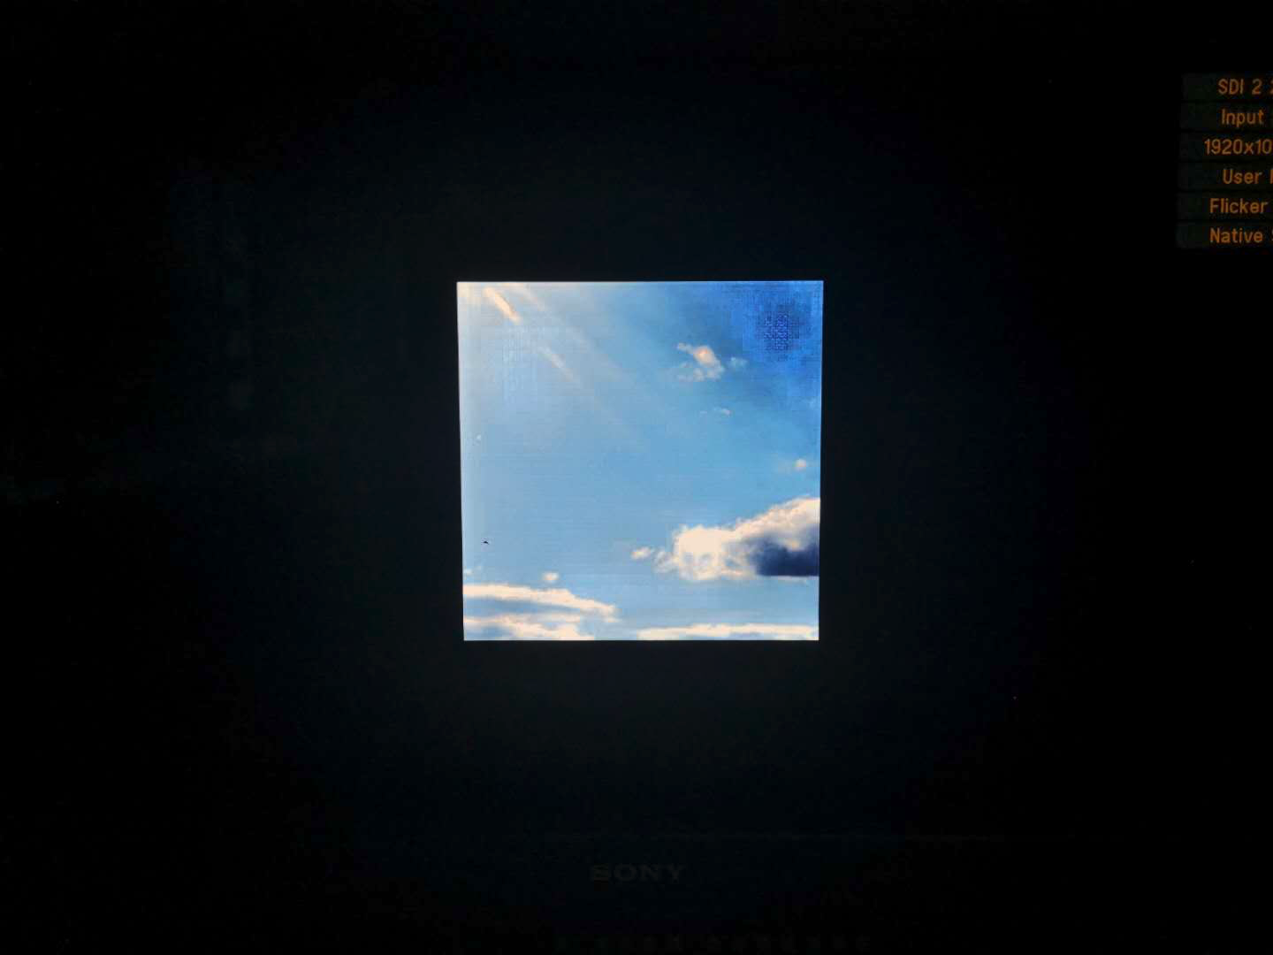
Examples - Viewing on HDR TV

Slide 30
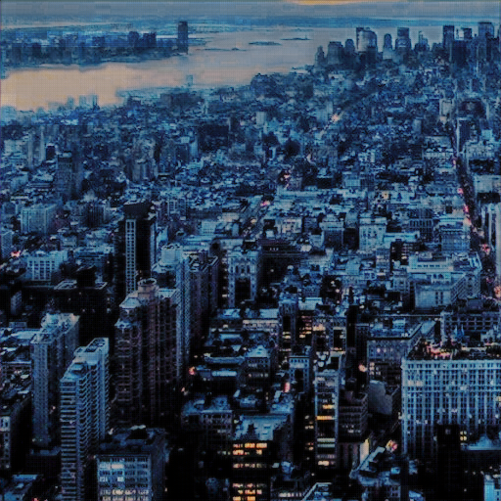
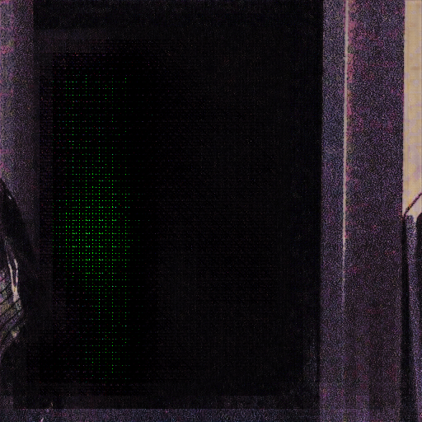
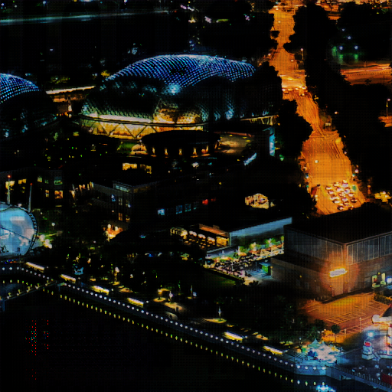
Challenges Encountered
Unwanted Artifacts:
Blocky shapes: Caused by inherent nature of kernel shape being a square.
Dotted patterns: Indicate an output of 0 in R, G, or B channels. Typically caused by dead neurons, or potential underfitting in CNN. So far these artifacts disappear over more epochs. Our models do use RELUs in the hidden layers. Hence, more possibly for dead neuron. Can attempt this in the future with "Leaky" ReLUs which has a small gradient in the negative region of activation curve.

Slide 31

Thank you!
Questions?

Slide 32

Extra Info – Activation Functions

Slide 33


Neuron

Slide 34

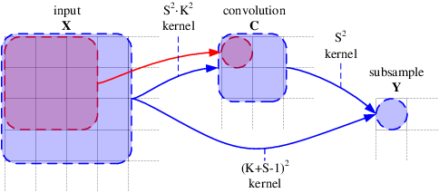
Kernels

